Slide 1

Hierachy To-do List
Jamie Liu, Jordan Han

Slide 2

Agenda
Introduction
Final Function List
Final Architecture
Excellent Features

Slide 3
Introduction
We want to build a to-do list that is clearly structured, well organized and fully visualized.

Slide 4
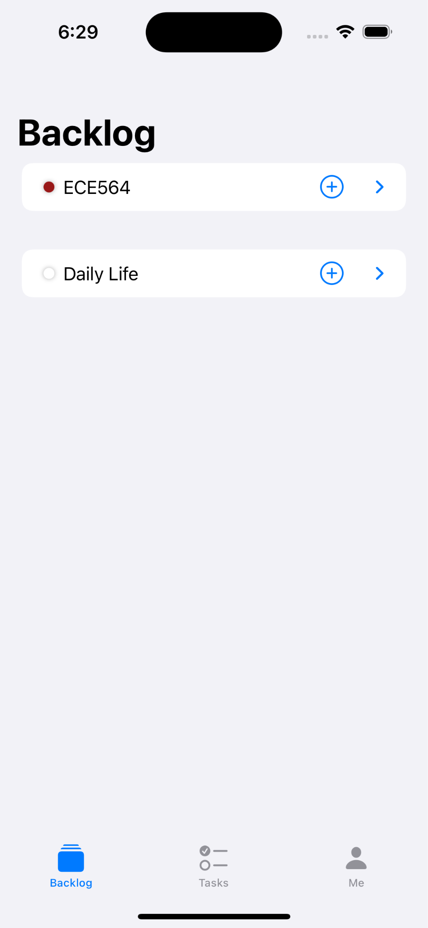
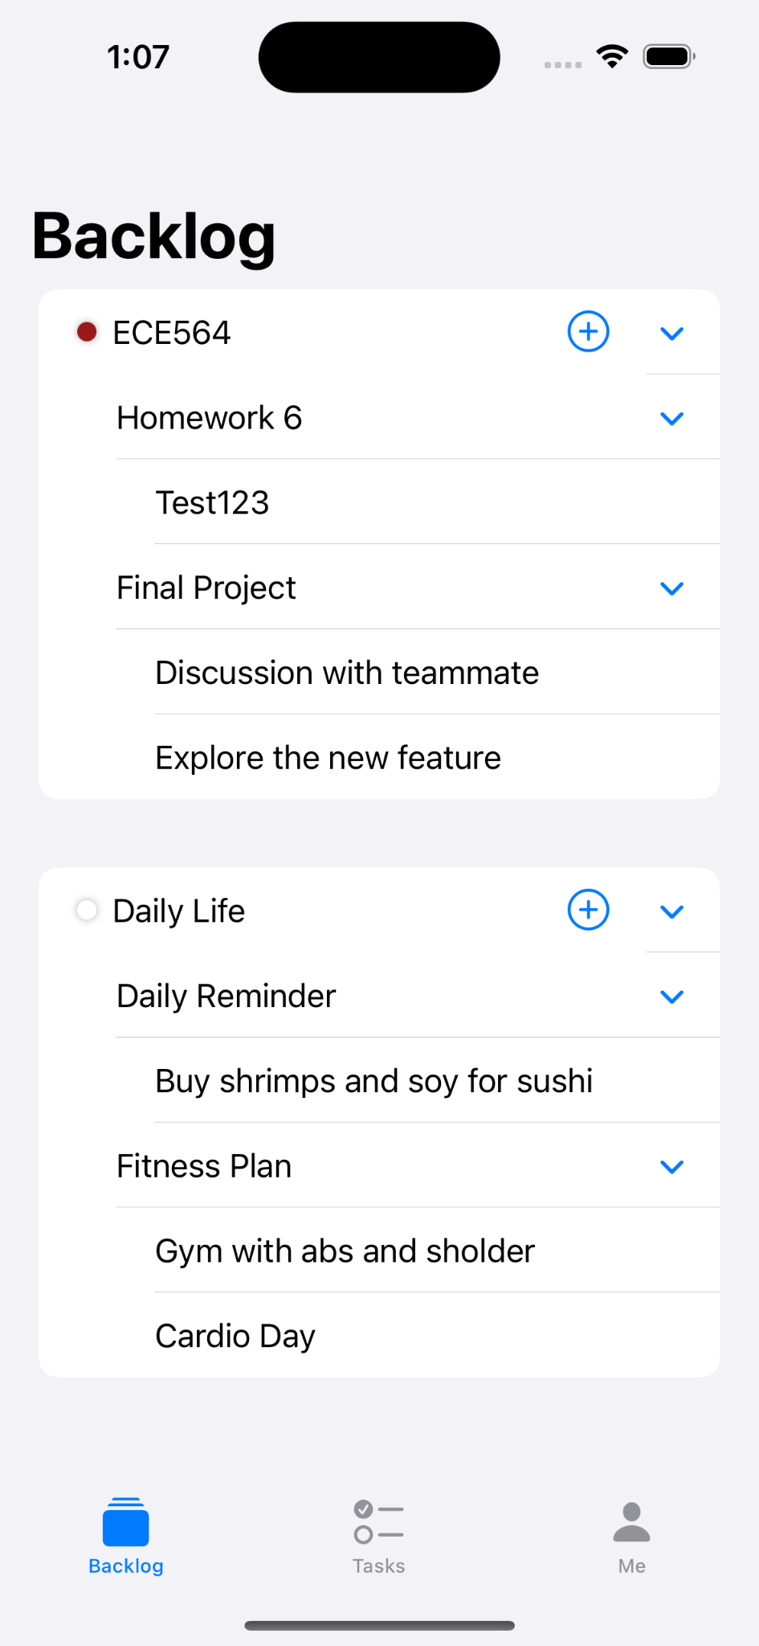
Introduction
Clearly Structured
We use the structure of Epic, Story and Task to make a basic 3-tier hierarchy.

Slide 5
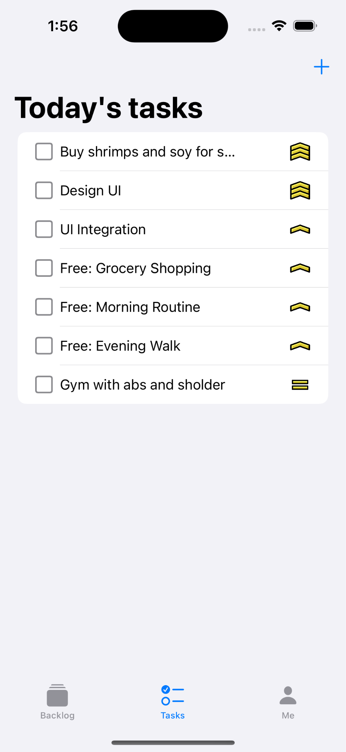
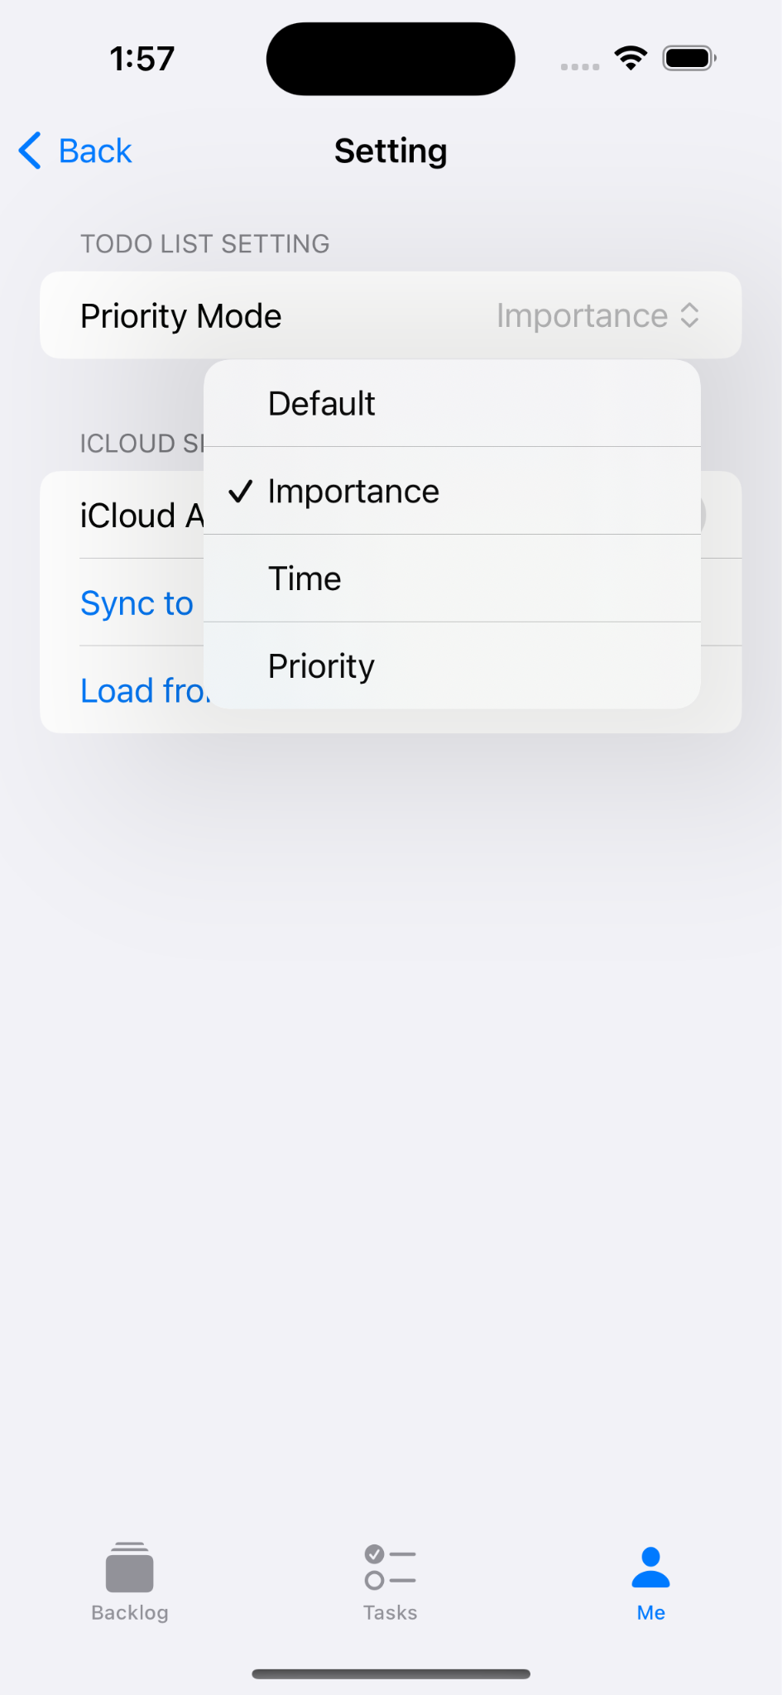
Introduction
Well Organized
Four different modes of priority mode to arrange the tasks in the order you wish.
Priority = 2.5 x Importance + 2.5 x 1 / Remaining Time

Slide 6
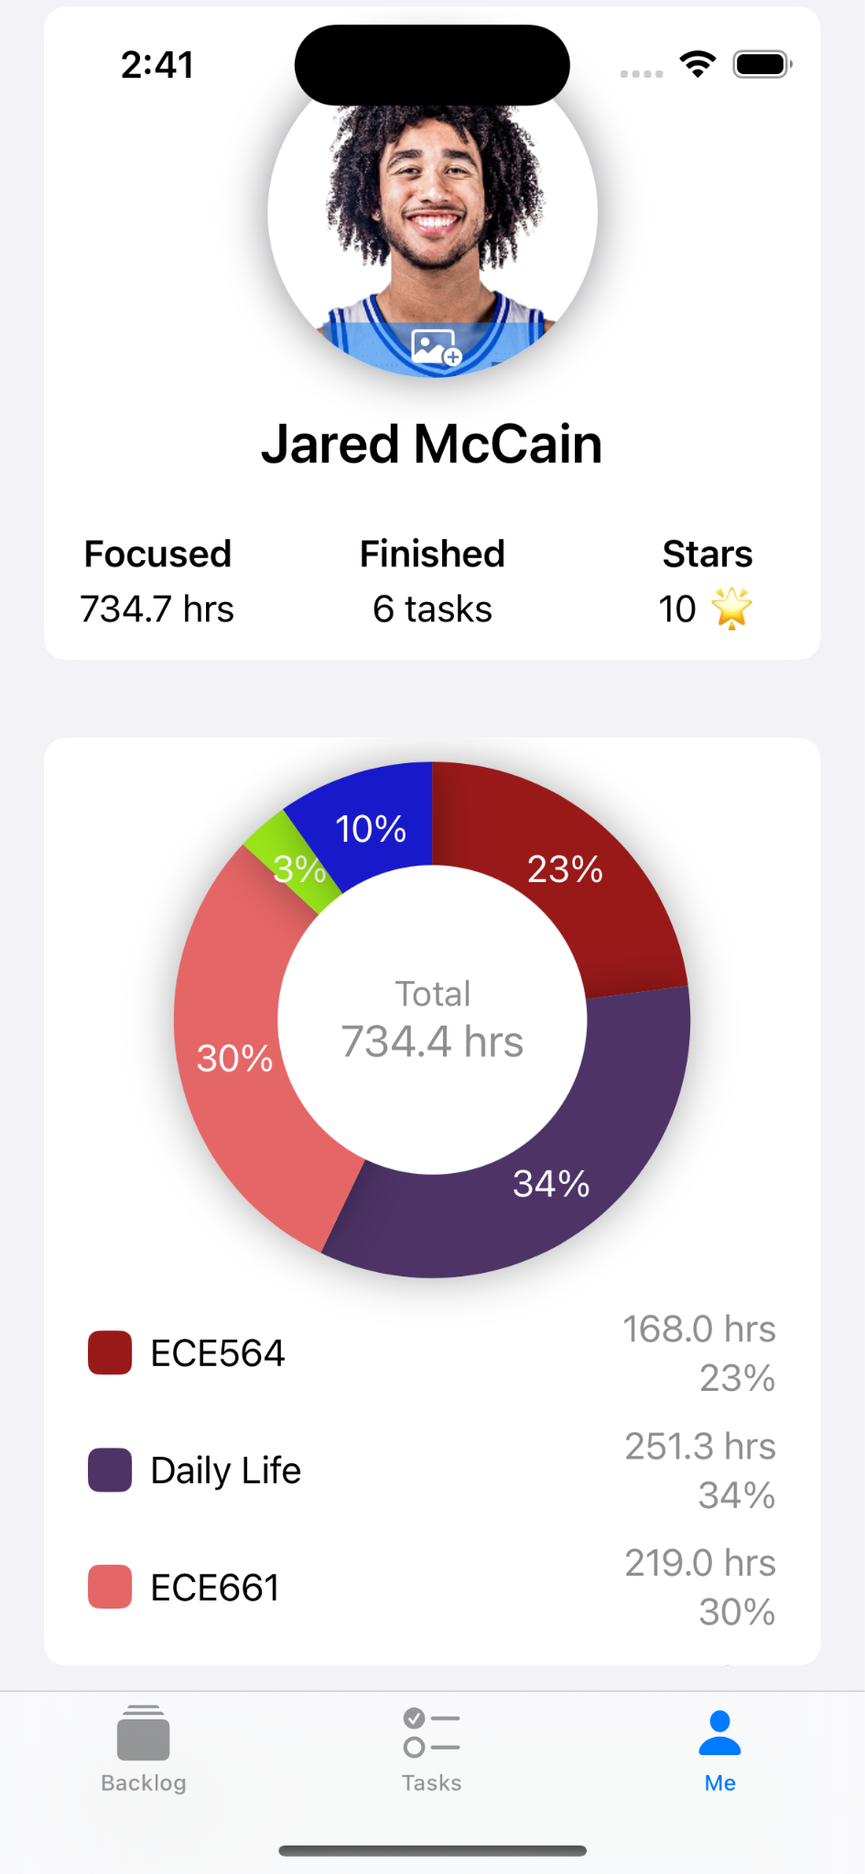
Introduction
Fully Visualized
We use graphs to visualize the time spent on each epics, so that users can better review and improve the schedule.

Slide 7
2. Final Function List
/// Sync data between local sandbox and iCloud
func loadFrom(url: URL) -> Bool
func SaveTo(url: URL) -> Bool
/// Query tasks based on variadic parameters
func queryTasks(conditions: (Task) -> Bool...) ->
[Task]
/// Calculate time distribution of task status
func statusDistribution() -> [Status:TimeInterval]
/// Custom sorting of specific array generics
extension Array where Element == Task {
mutating func sortByPriority(mode: PriorityMode
= .Default)
/// Request access to calendar and reminders
func requestEvents(_ completion: @escaping
(EKEventStore) -> Void)
func requestReminders(_ completion: @escaping
(EKEventStore) -> Void)
/// Custom firework animation
struct FireworksEffect: View
/// Custom camera view for taking picture
struct CameraControllerView: UIViewControllerRepresentable
Notes:
These are part of many of our functions.
Thanks to iCloud also support URL, like the local sandbox, our load and save are quite clear.
We added this query function to filter tasks in the 3-layer hierarchy.
This statusDistribution is used to Count the total duration of tasks in different statuses.
We also leverage Swift’s Generic Specialization for specific Type to support our custom sorting algorithm.
Here are two functions for access Calendar & Reminder.
Here are our Fireworks Animation and CameraControllerView for taking photo.

Slide 8
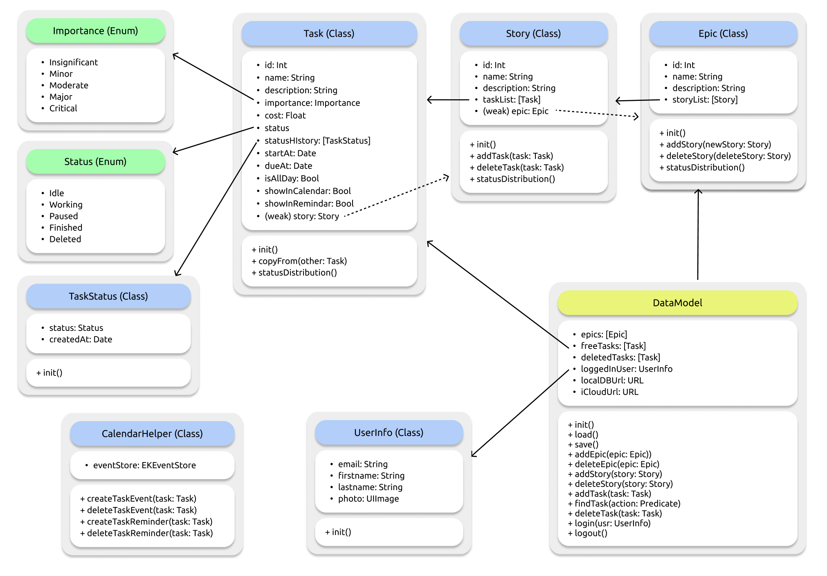
3. Final Architecture
3-level Hierarchy:
Epic - Story - Task
Class over Struct:
flexiable & easy to bind
Notes:
This is our final architecture.
Normally tasks are organized inside the 3-level hierarchy,
but we also support free tasks so user don’t have to worry about the hierarchy every time.
Epic, Story and Task are all Class instead of Struct, so that we want leverage the SwiftUI’s latest version State & Binding,
which are flexible and easy to use, make the dependency tree of View and Model more clear.

Slide 9



3. Final Architecture
iCloud
Why JSON:
Flexible, Structured, Lightweight
Why iCloud:
No backend server, Privacy & Security,
Seamless User Exprience
Sandbox
Sandbox
Notes:
When it comes to storage, we choose JSON because it is flexible, structured and lightweight.
Both iCloud and local Sandbox are accessible via URL, so JSON works very well with them.
Our main goal is to share the Model Data between user’s devices,
iCloud can provide good privacy & security & seamless user experience.

Slide 10
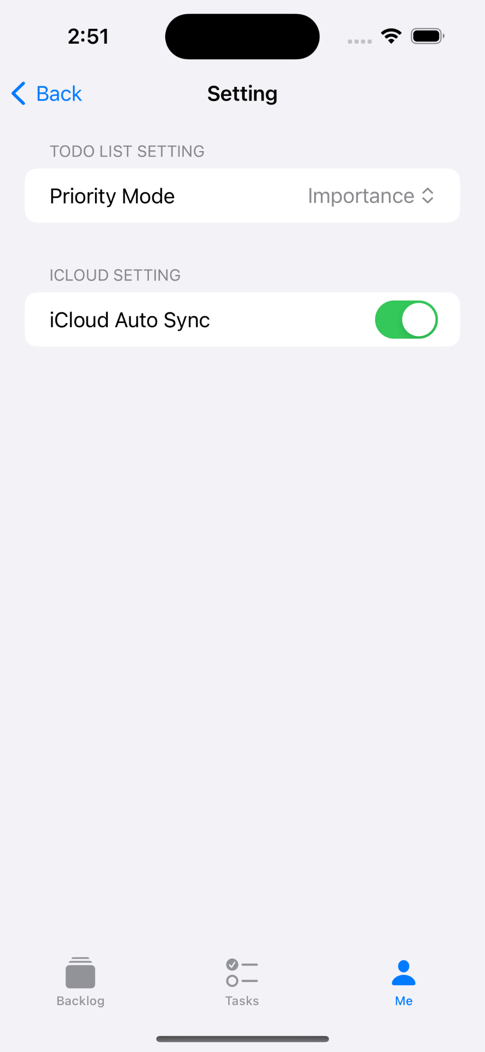
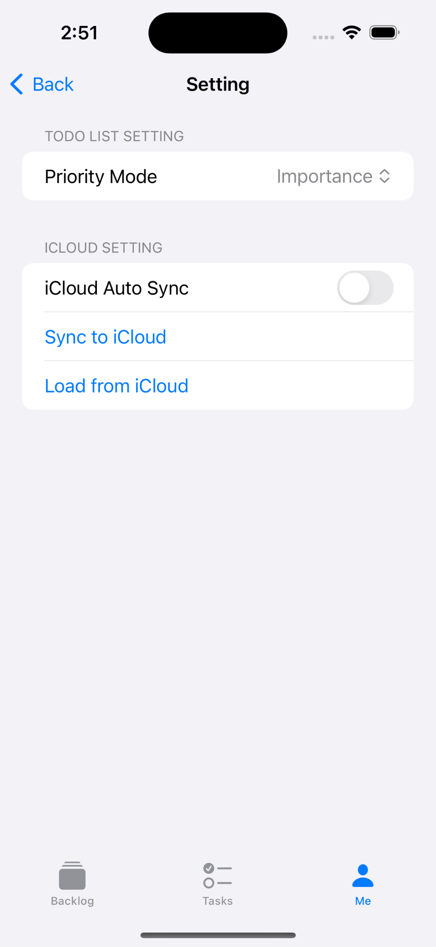

4. Excellent Features
iCloud
You can use iCloud to sychornize and backup your data. Automatically or manually upload/download data.

Slide 11
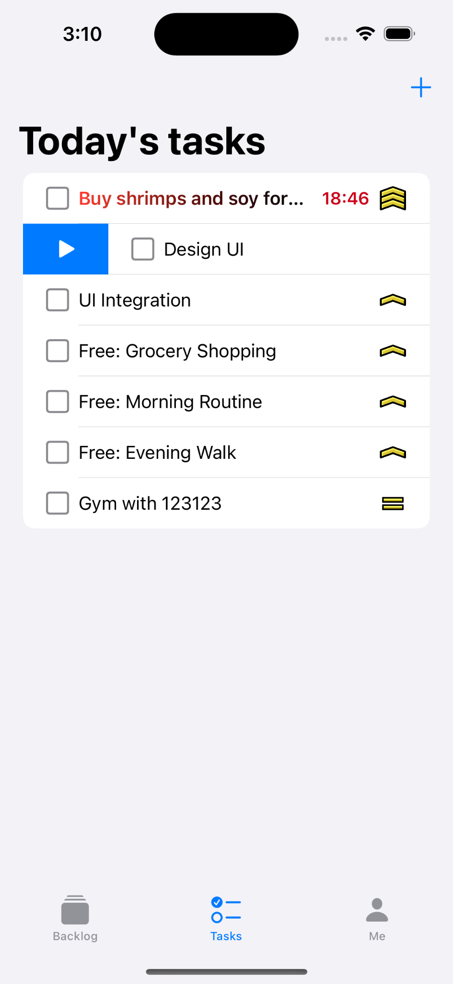
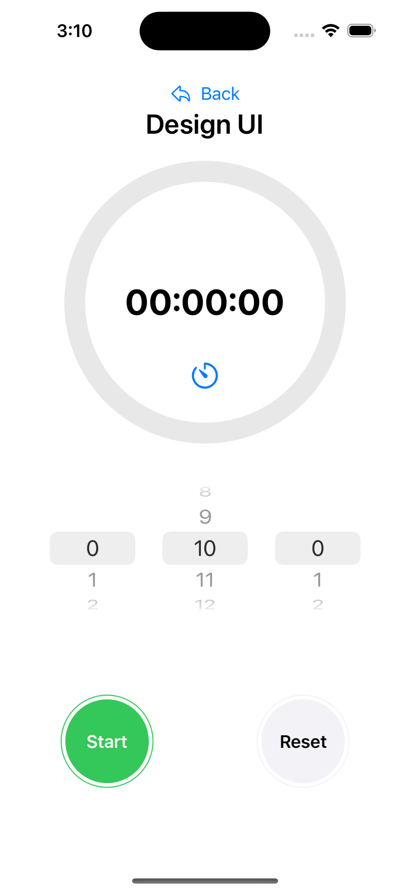
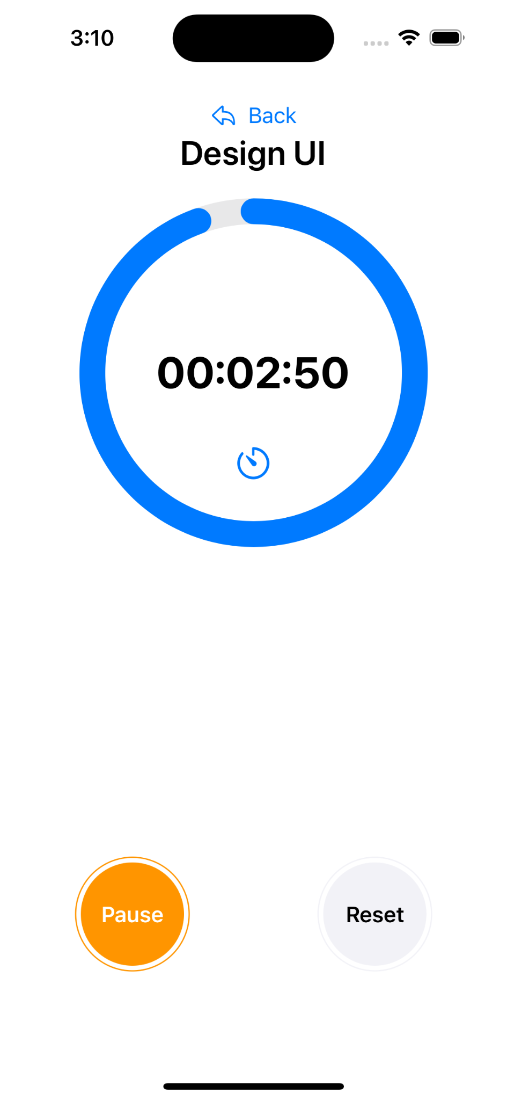
4. Excellent Features
Focus Clock
It helps you to focus on a certain task and countdown by the time you set.

Slide 12
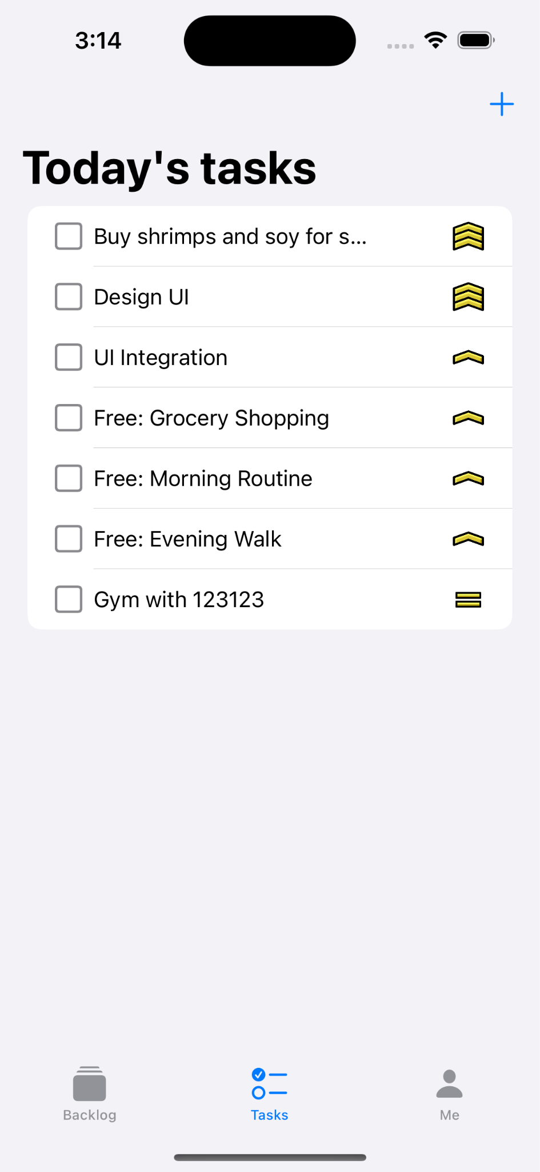
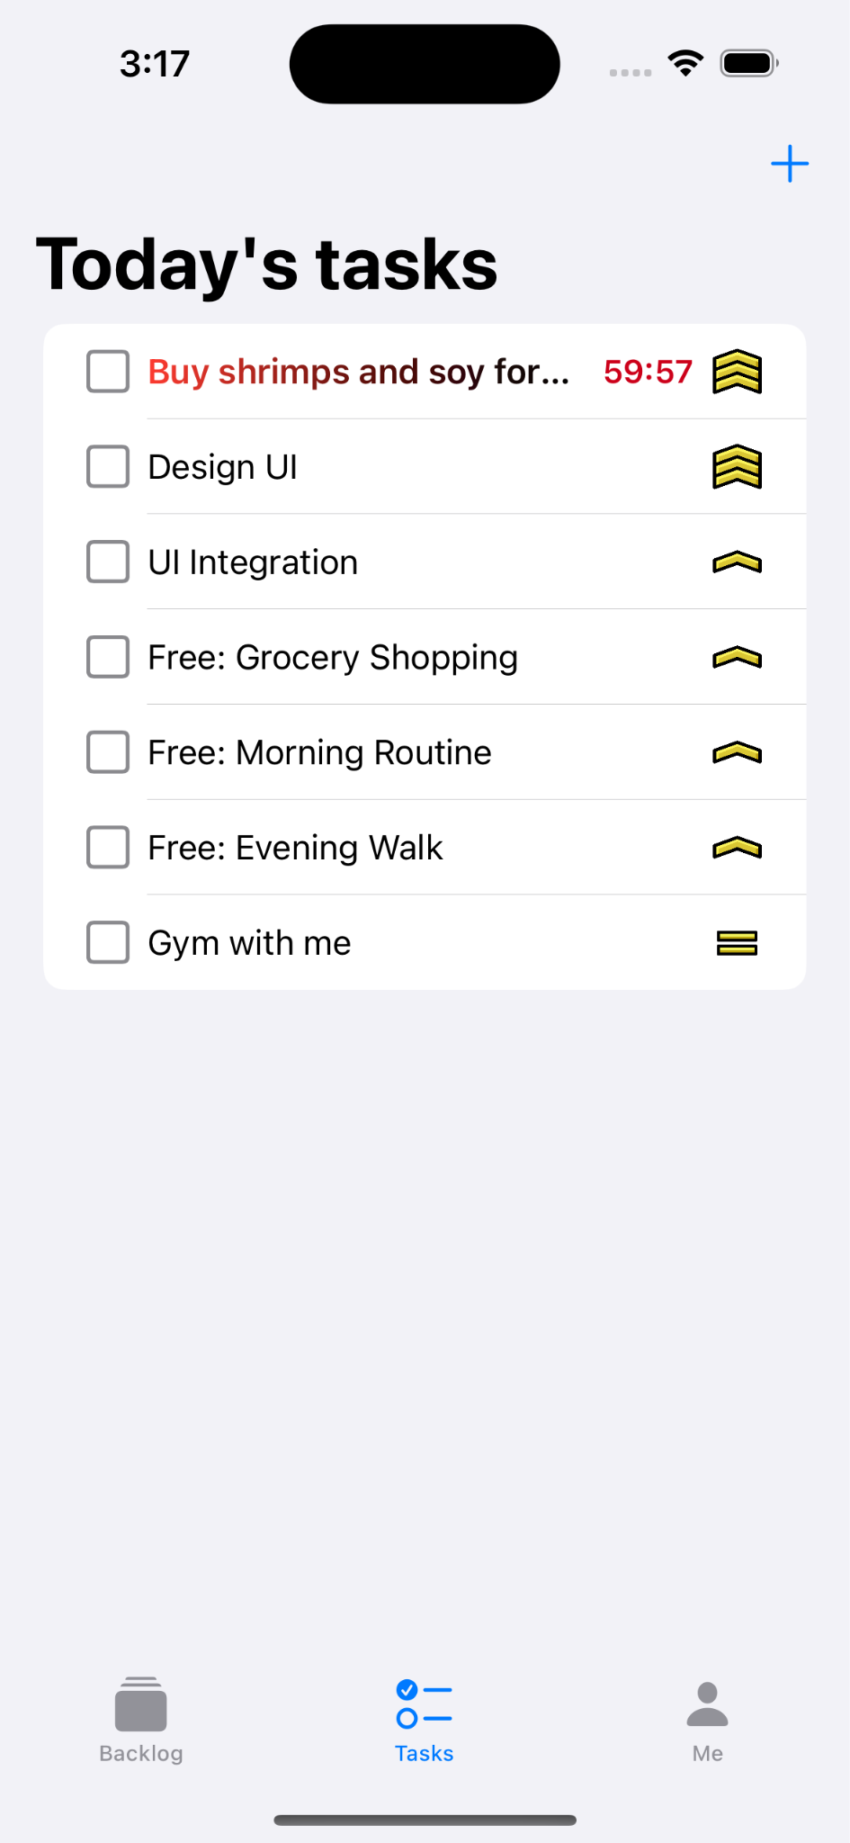
4. Excellent Features
Deadline Notification
If you set a due date for your app, it will give you a strong visual warning on how much time left.

Slide 13
Demo Time
Q&A

